Slide 1
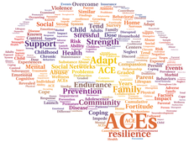

Understanding and Responding to Adverse Childhood Experiences in the School Setting
Pamela Kahn, MPH, RN, NCSN
Coordinator, Health and Wellness
Orange County Department of Education

Slide 2
Focus
The types of stress/trauma and what makes an experience traumatic.
How trauma experienced during childhood affects brain development
What is the Adverse Childhood Experiences (ACE) Study
The relationship between ACEs and subsequent youth health and behaviors
The role of the school in working with trauma exposed students
Self care for school staff

Slide 3
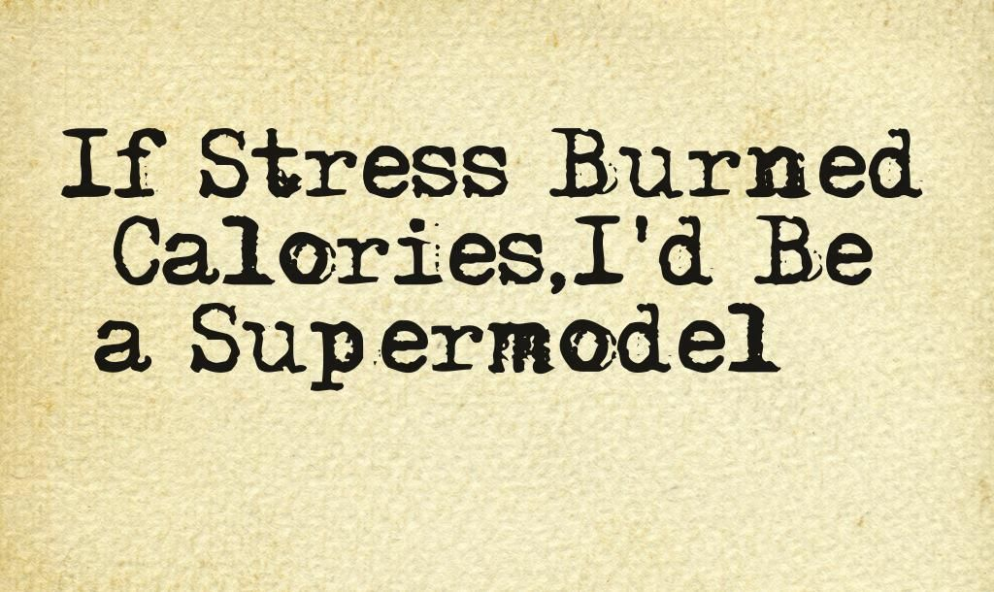


Slide 4
Trauma vs. Stress
Trauma
  A sudden event that dramatically explodes into our lives and changes the way we perceive the world
  Often life-threatening
Stress
  A reaction to less dramatic and often daily events that are perceived as threatening such as a job interview, deadlines, finances, or worries related to an ongoing security situation.
  Typically do not feel a loss of control
Herzog Israel Center for the Treatment of Psychotrauma

Slide 5
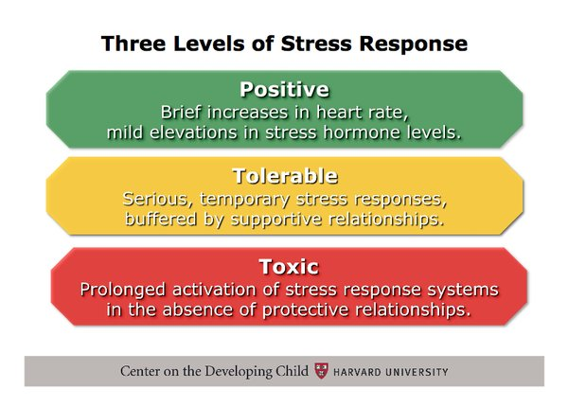

Slide 6



Eustress
(Positive Stress)
Stressful, but primarily positive experiences. Short term, motivates and focuses energy. Experience is within our coping abilities, feels exciting and improves performance
  Receiving a promotion or raise at work
  Starting a new job
  Marriage
  Buying a home
  Having a child
  Moving
  Taking a vacation
  Holiday seasons
  Retiring
  Taking educational classes or learning a new hobby

Slide 7
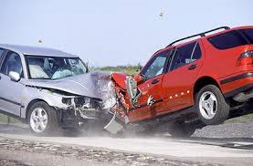

Tolerable Stress
(Acute Trauma)
    Single incident (crime victim, serious accident, natural disaster)
    Treatment includes immediate support, removal from the scene of the trauma, use of medication for immediate relief of grief, anxiety, and insomnia, and brief supportive psychotherapy provided in the context of crisis intervention.

Slide 8

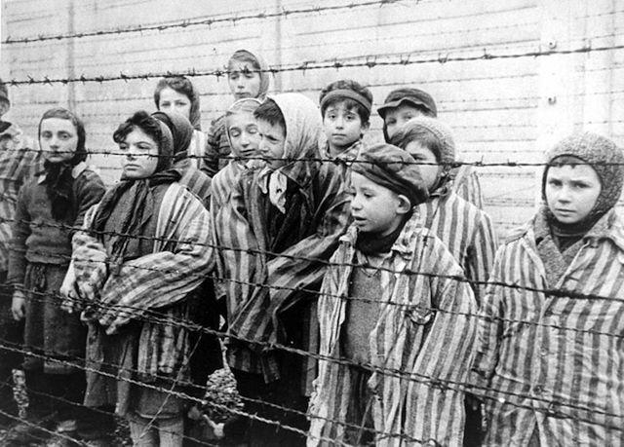
Toxic Stress
(Complex Trauma/PTSD/Extreme Stress)
    Protracted exposure to prolonged social and/or interpersonal trauma in the context of dependence, captivity or entrapment. (ex. chronic maltreatment, neglect or abuse in a care-giving relationship, hostages, prisoners of war, concentration camp survivors, and survivors of some religious cults).
    Often results in borderline or antisocial personality disorder or dissociative disorders.
      Behavioral difficulties (such as impulsivity, aggression, sexual acting out, eating disorders, alcohol or drug abuse, and self-destructive actions)
      Extreme emotional difficulties (intense rage, depression, or panic) and mental difficulties (fragmented thoughts, dissociation, and amnesia).
    The treatment of such patients often takes much longer, may progress at a much slower rate, and requires a sensitive and highly structured treatment program delivered by a team of trauma specialists
Notes:
Complex PTSD (sometimes called “Disorder of Extreme Stress”) is found among individuals who have been exposed to prolonged traumatic circumstances, especially during childhood, such as childhood sexual abuse

Slide 9
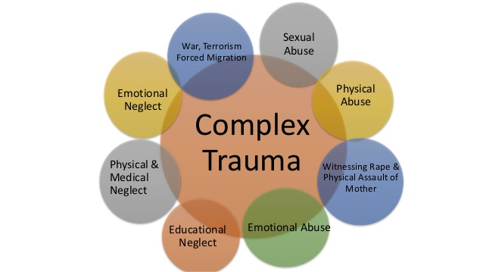
Toxic Stress/Complex trauma
Is chronic
Often begins in early childhood
Occurs within the primary caregiving system and/or social environment

Slide 10
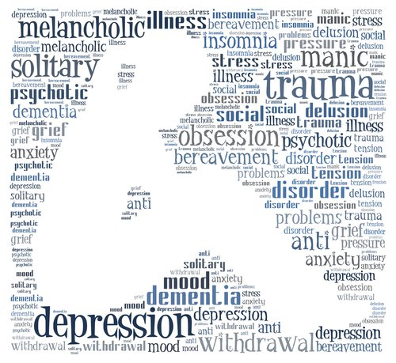
What is Trauma?
The word “trauma” is used to describe experiences or situations that are emotionally painful and distressing, and that overwhelm people’s ability to cope, leaving them powerless. (Center for Nonviolence & Social Justice, 2016)
*

Slide 11

What Makes an Experience Traumatic?
Overwhelming, very painful, very scary
Fight or Flight incapacitated
Threat to physical or psychological safety
Loss of control
Unable to regulate emotions
Trauma is the response to the event, not the event itself.
Notes:
Source: UCSF HEARTS; Wright; NCTSN
This slide lists the presumptions I’m coming from in this presentation—that your students DO experience trauma; that trauma DOES impact learning; and that addressing complex trauma IS the business of schools
60 % of CA kids have at least one ACE; 60 % of youth are exposed to violence
Trauma affects how kids process information, language, self-regulate, and ability to form trusting and effective relationships
Trauma sensitive schools can be a buffer, and promote resilience. MUST be a whole school process.
“Resilience is defined as doing better than expected. We define resilience as the way we think children ought to behave; however, what is resilient in one environment may be a risk in another” (Travis Wright, Ph.D., 2014)

Slide 12
Trauma
Prevalent in the lives of children
Causes physical and emotional distress and affects learning and school performance
Children/teens experience the same emotions as adults, but may not have the words to express them
Schools have an important role to play in meeting the social/emotional needs of students
Trauma sensitive schools help children feel safe to learn
Notes:
Source: UCSF HEARTS; Wright; NCTSN
This slide lists the presumptions I’m coming from in this presentation—that your students DO experience trauma; that trauma DOES impact learning; and that addressing complex trauma IS the business of schools
60 % of CA kids have at least one ACE; 60 % of youth are exposed to violence
Trauma affects how kids process information, language, self-regulate, and ability to form trusting and effective relationships
Trauma sensitive schools can be a buffer, and promote resilience. MUST be a whole school process.
“Resilience is defined as doing better than expected. We define resilience as the way we think children ought to behave; however, what is resilient in one environment may be a risk in another” (Travis Wright, Ph.D., 2014)

Slide 13
Prevalence of Youth Trauma
38% of children and adolescents experienced at least one potentially traumatic event.
  26% of children in the United States will witness or experience a traumatic event
  before they turn four.
In a nationally representative survey of 12- to 17-year-old youth, 8 percent reported a lifetime prevalence of sexual assault, 17 percent reported physical assault, and 39 percent reported witnessing violence
In a community sample of older adolescents, 14.5 percent of those who had experienced a serious trauma developed PTSD (5% of adolescents have met criteria for PTSD in their lifetime)
Students living in poverty, homelessness, and with other social vulnerabilities are significantly more apt to experience stress and trauma.
National Children’s Survey, 2016
Notes:
Studies estimate 3.3 – 10 million children in the United States witness violence in their own homes each year (1).

Slide 14
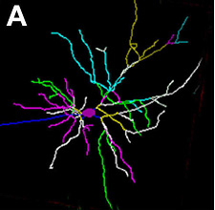
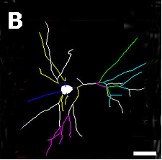
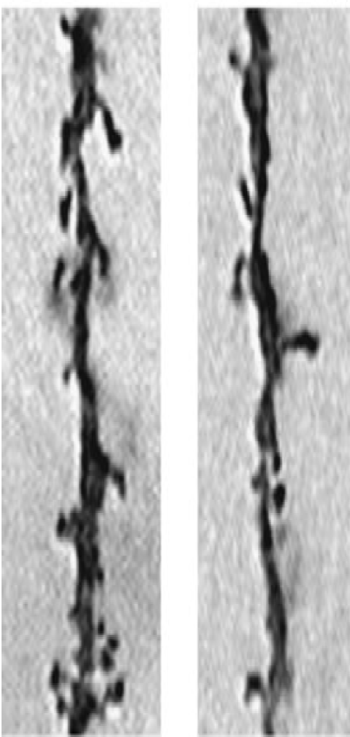
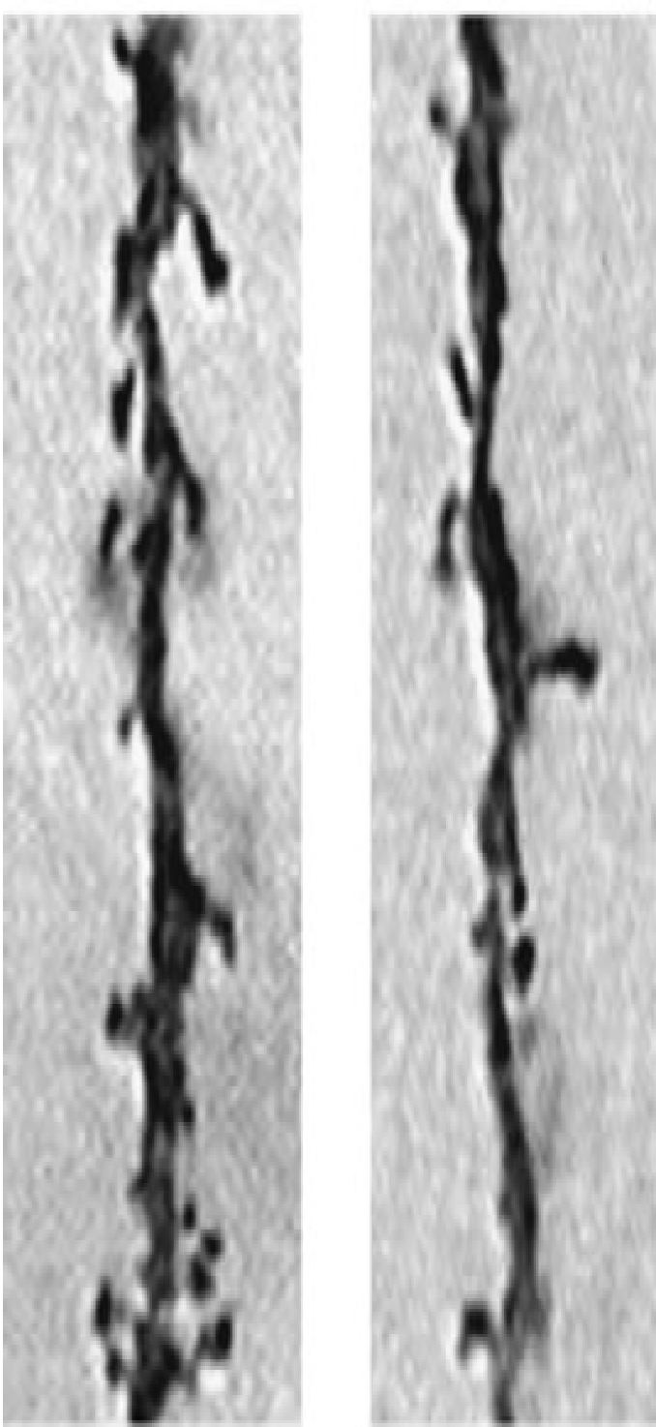
Persistent Stress Changes Brain Architecture
(Prefrontal Cortex and Hippocampus)
Normal
Chronic
stress
Typical -
neuron with many connections
Neuron damaged by toxic stress – fewer connections
Bock et al Cer Cort 15:802 (2005)
Source: C. Nelson (2008)
Notes:
Brain architecture is created by the formation of connections between neurons as a result of interactions with one’s environment, and then the pruning of connections that aren’t used. Neural connections in different areas of the brain are responsible for different kinds of activities. For example, the prefrontal cortex and hippocampus house activities related to memory and decision-making (executive function). As you can see from these depictions of neurons, brains subjected to chronic stress have underdeveloped connections in the areas of the brain most critical for success in school, work, and behavior.
In contrast, the Amygdala is the area of the brain that governs our “fear response”. As you can see, in brains subjected to chronic stress, neurons have OVERdeveloped connections in this area -- which can result in exaggerated assessment of and response to fearful situations.

Slide 15
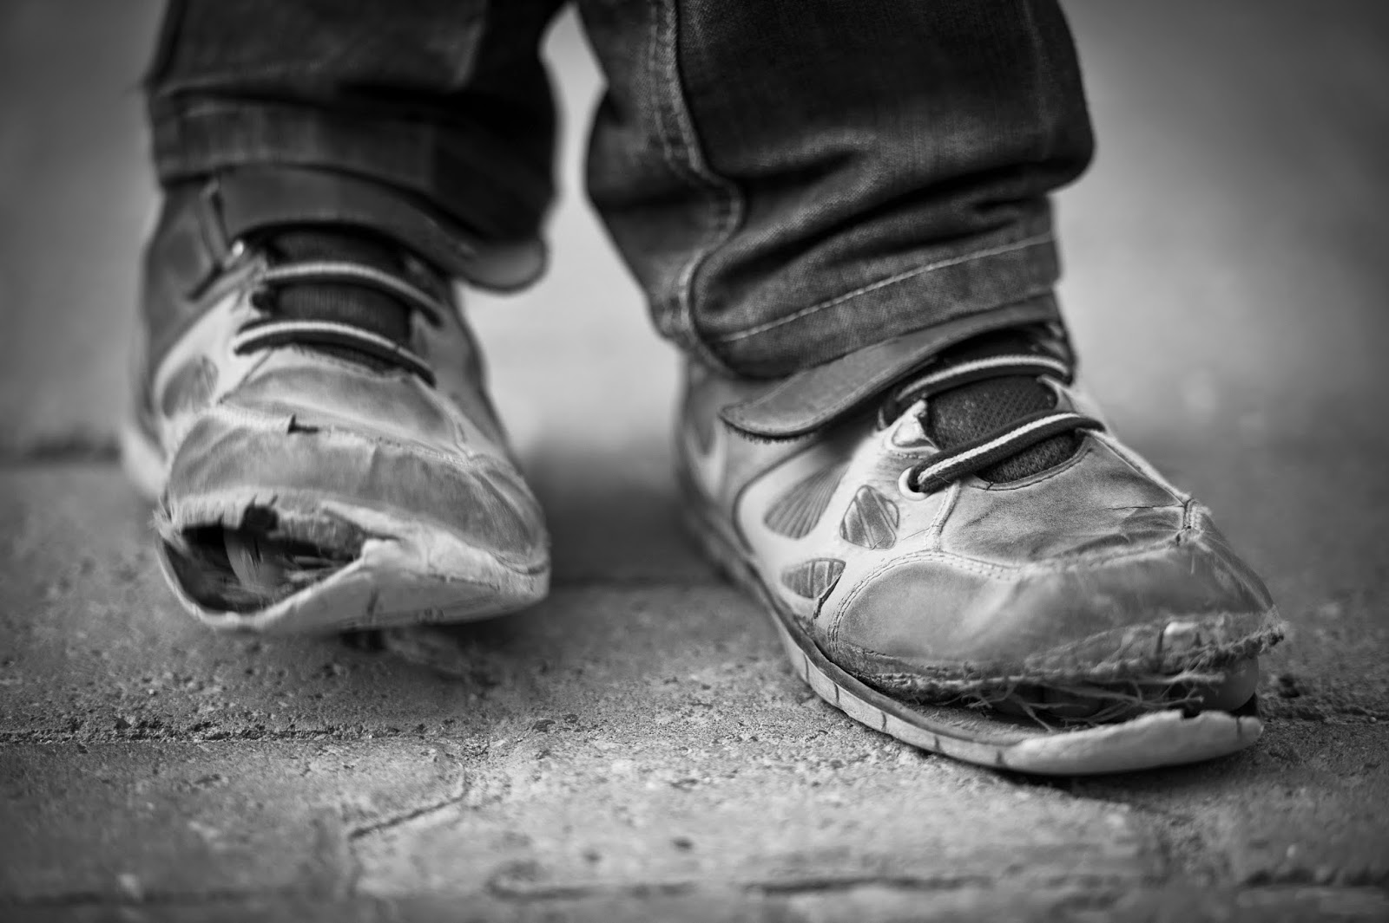
Poverty’s Toll
Poverty and the conditions that often accompany it—violence, excessive noise, chaos at home, pollution, malnutrition, abuse and parents without jobs—can affect the interactions, formation and pruning of connections in the young brain.

Slide 16
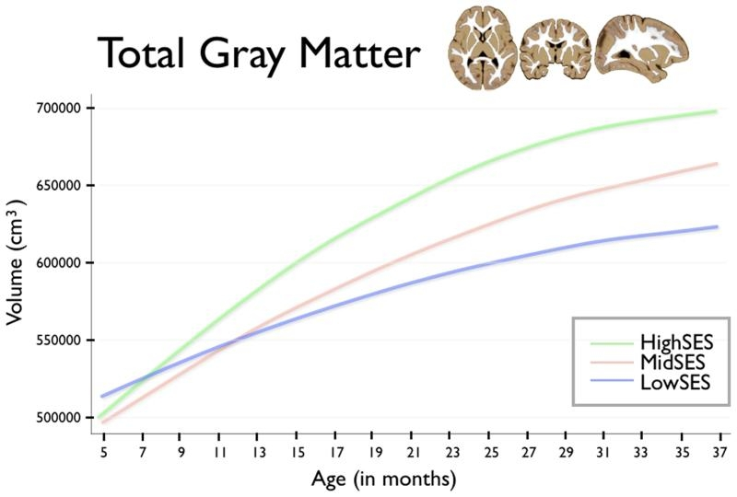
Poverty Decreases Brain Gray Matter
46.0% of children in the state were poor or near poor with another 4.7% living in deep poverty
Public Policy Institute of California, 2018
www.sciencedaily.com

Slide 17
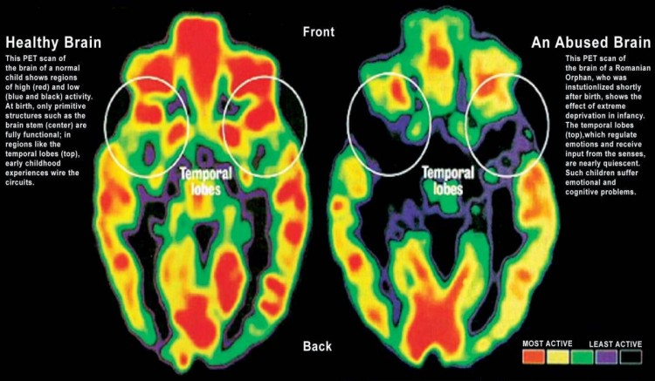
Physical Effects of Trauma on the Brain

Slide 18
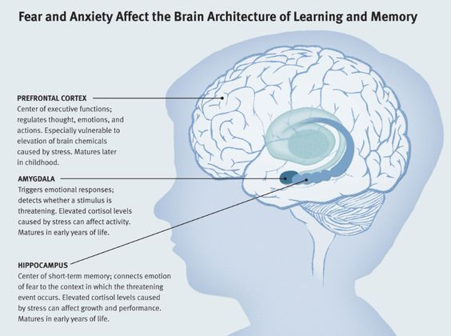
T
www.thedevlopingchild.net

Slide 19
Trauma’s Impact on Brain Development
Attachment: Trouble with relationships, boundaries, empathy & social isolation
Physical Health: Impaired sensorimotor development, coordination problems, increased medical problems & somatic symptoms
Emotional Regulation: Difficulty identifying or labeling feelings and communicating needs
Dissociation: Altered states of consciousness, amnesia, impaired memory
Cognitive Ability: Problems with focus, learning, processing new information, language development, planning & orientation to time & space
Self-Concept: Lack of consistent sense of self, body image issues, low self-esteem, shame & guilt
Behavioral Control: Difficulty controlling impulses, oppositional behavior, aggression, disrupted sleeping & eating patterns, trauma re-enactment
Source; Cook, A., Spinazzola, P., Ford, J., Lanktree, C., Blaustein, M., Cloitre, M., et al. (2005). Complex trauma in children and adolescents. Psychiatric Annals, 35(5), 390-398.

Slide 20
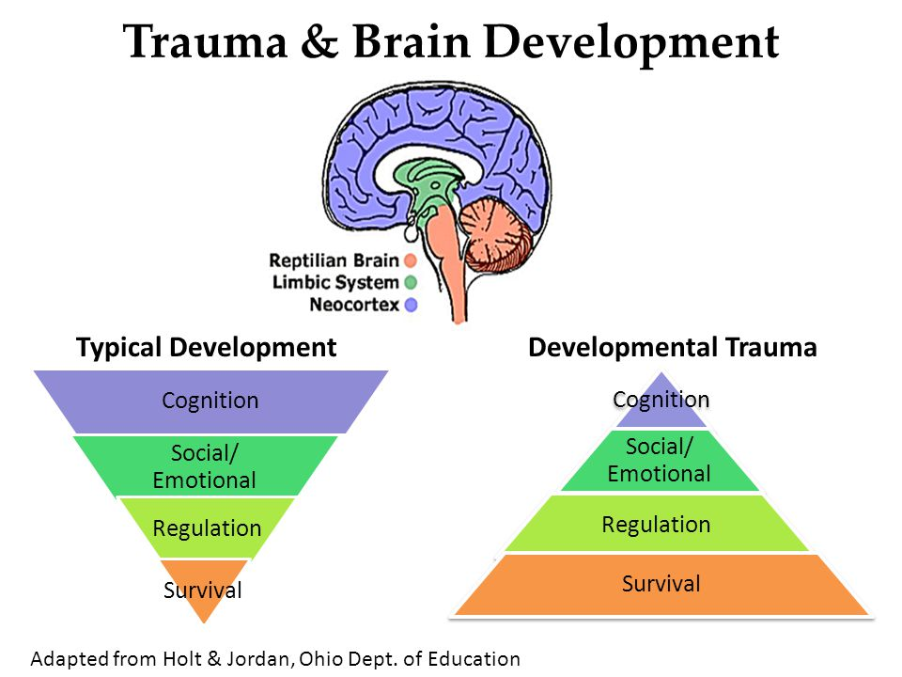

Slide 21
Impacts of Trauma on Child Behavior
Trauma causes brain to adapt in ways that contributed to their survival (i.e. constant fight/flight/freeze).
↓
These adaptations can look like behavior problems in “normal” contexts, such as school.
↓
When triggered, “feeling” brain dominates the “thinking” brain.
↓
The normal developmental process is interrupted, and students may exhibit internalizing or externalizing behaviors.
Notes:
Kids who experience complex or chronic trauma may always be “activated” or in “fight/flight/freeze”. Record player groove. Remember the idea of use it or lose it? Most used neural pathways have the strongest connections! Over time, exposure to trauma leads to physiological adaptations in the brain and body.
Fight or flight response is a stress response that should only be activated when in danger, and constant stress impacts brain development
Children will be aroused by even the perception of threat. Trauma undermines a young person’s ability to:
Regulate emotions
Develop a sense of self and exhibit appropriate interpersonal realtionships
Feel safe to explore
Tolerate new situations and change.

Slide 22
Fight, Flight & Freeze
What do these Look Like in Children?
FIGHT
  Hyperactivity, verbal aggression, oppositional behavior, limit testing, physical aggression, “bouncing off the walls”
FLIGHT
  Withdrawal, escaping, running away, self-isolation, avoidance
FREEZE
  Stilling, watchfulness, looking dazed, daydreaming, forgetfulness, shutting down emotionally

Slide 23
Consequences of Complex Stress/Trauma
Students overloaded with stress hormones and unable to function appropriately can’t focus on schoolwork.
They fall behind in school/fail to develop healthy relationships with peers or create problems with school staff because they are unable to trust adults.
With failure, despair, and frustration pecking away at their psyches, they find solace in food, alcohol, tobacco, methamphetamines, inappropriate sex, high-risk sports, and/or work.
They don’t regard these coping methods as problems. They see them as a way to obtain relief and to escape from depression, anxiety, anger, fear and shame.

Slide 24
Adverse Childhood Experiences (ACEs) Study
Partnership b/w Kaiser Permanente and CDC
The initial surveys began in 1995 and continued through 1997, with the participants followed subsequently for more than fifteen years.
Retrospective approach examined link between multiple types of childhood stressors and adult health for over 17,000 adult participants
Questionnaire asked for detailed information on past history of abuse, neglect and family dysfunction as well as current behaviors and health status..

Slide 25
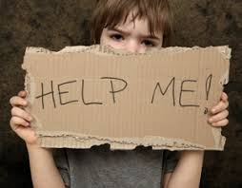
ACE Study Key Concept
Stressful or traumatic childhood experiences can result in social, emotional, and cognitive impairments.
Fear-based childhoods disrupt neurodevelopment, and can actually alter normal brain structure and function.

Slide 26
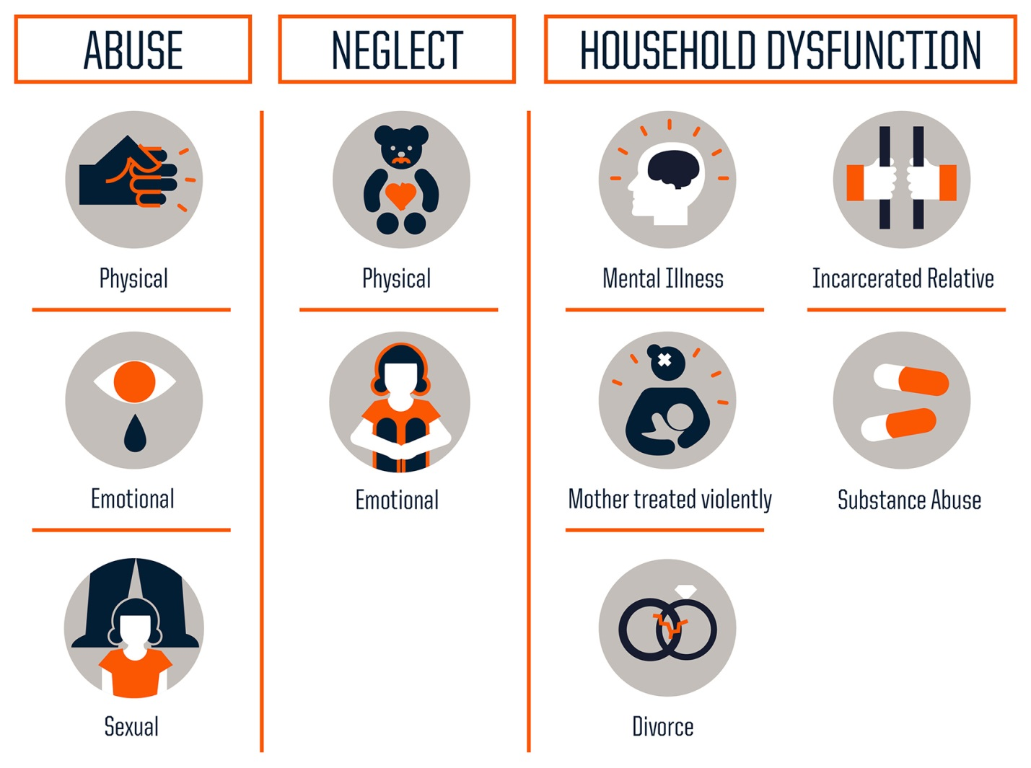
Three Types of ACEs
http://www.npr.org/assets/img/2015/02/20/aces-1_custom.jpg

Slide 27
ACE Score
The ACE score is the total number of ACEs that each participant reported.
  For example, experiencing physical neglect would be an ACE score of one; if the child also witnessed a parent being treated violently, the ACE score would be two.
  The higher the score, the higher the risk for later health problems.
  Given an exposure to one category, there is an 80% likelihood of exposure to another.

Slide 28
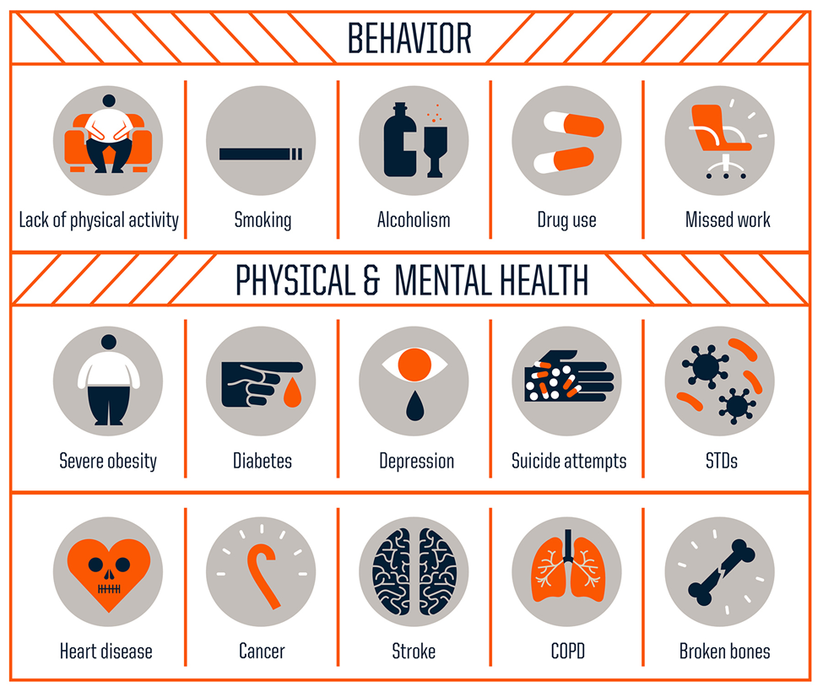
ACEs Increase Health Risks

Slide 29
The ACE Questionnaire
Prior to your 18th birthday:
Did a parent or other adult in the household often or very often… Swear at you, insult you, put you down, or humiliate you? or Act in a way that made you afraid that you might be physically hurt?
No___If Yes, enter 1 __
Did a parent or other adult in the household often or very often… Push, grab, slap, or throw something at you? or Ever hit you so hard that you had marks or were injured?
No___If Yes, enter 1 __
Did an adult or person at least 5 years older than you ever… Touch or fondle you or have you touch their body in a sexual way? or Attempt or actually have oral, anal, or vaginal intercourse with you?
No___If Yes, enter 1 __
Did you often or very often feel that … No one in your family loved you or thought you were important or special? or Your family didn’t look out for each other, feel close to each other, or support each other?
No___If Yes, enter 1 __
Did you often or very often feel that … You didn’t have enough to eat, had to wear dirty clothes, and had no one to protect you? or Your parents were too drunk or high to take care of you or take you to the doctor if you needed it?
No___If Yes, enter 1 __
Was a biological parent ever lost to you through divorce, abandonment, or other reason ?
No___If Yes, enter 1 __
Was your mother or stepmother:
Often or very often pushed, grabbed, slapped, or had something thrown at her? or Sometimes, often, or very often kicked, bitten, hit with a fist, or hit with something hard? or Ever repeatedly hit over at least a few minutes or threatened with a gun or knife?
No___If Yes, enter 1 __
Did you live with anyone who was a problem drinker or alcoholic, or who used street drugs?
No___If Yes, enter 1 __
Was a household member depressed or mentally ill, or did a household member attempt suicide? No___If Yes, enter 1 __
Did a household member go to prison?
No___If Yes, enter 1 __
Now add up your “Yes” answers: _ This is your ACE Score

Slide 30
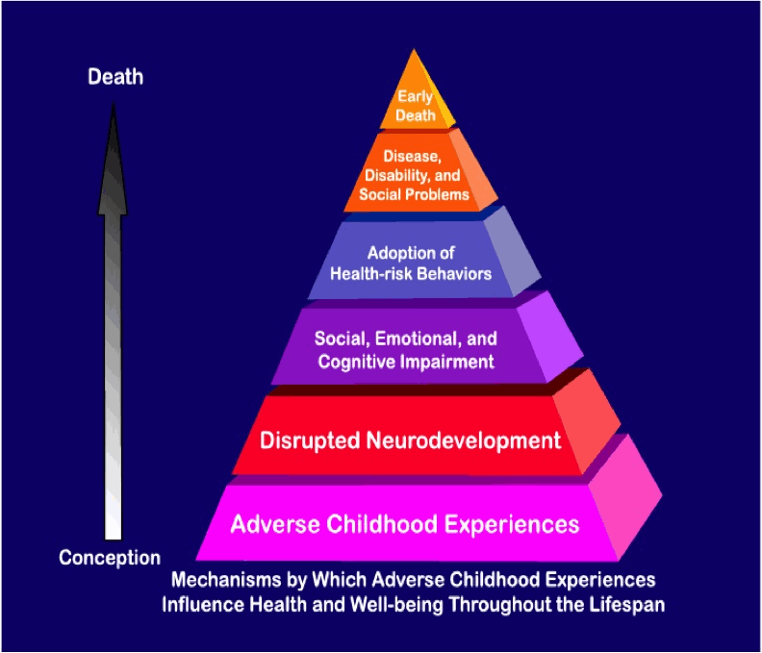
The ACE Study Pyramid
Notes:
Illustrates how childhood adversity leads to disease, disability, social problems and possibly early death.

Slide 31
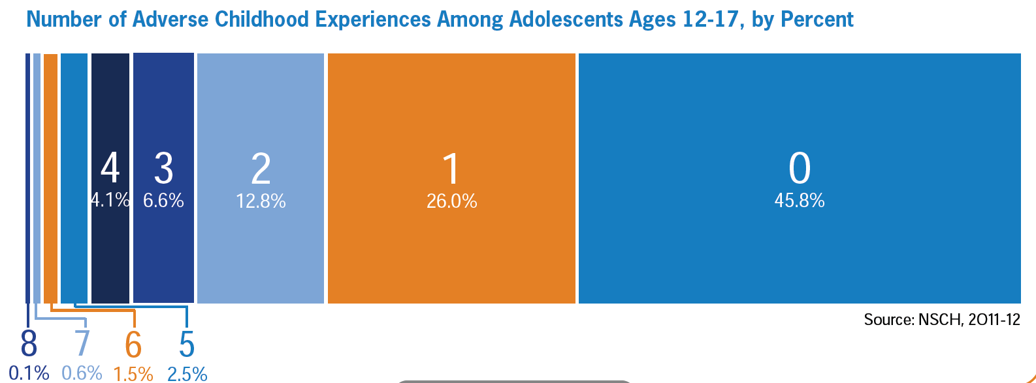
More than half of adolescents have had at least one of these adverse childhood experiences, and nearly one in ten have experienced four or more.

Slide 32
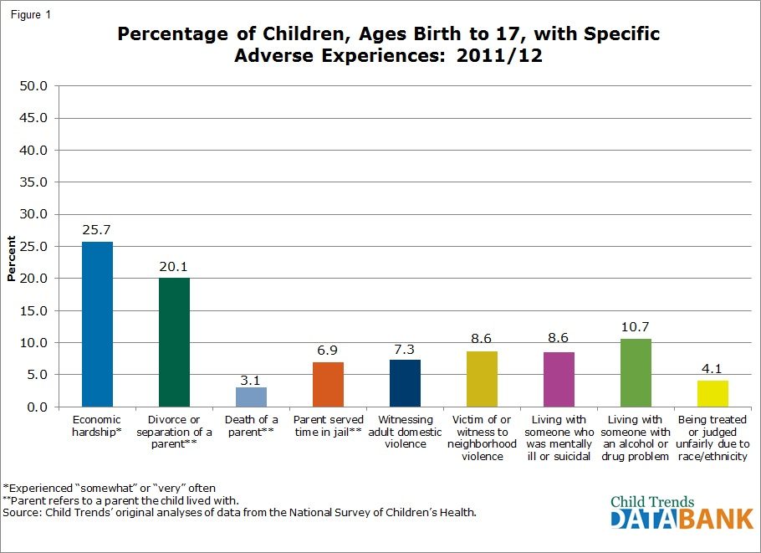

Slide 33
Disparities by Race & Ethnicity
Black and Hispanic children in almost all regions of the U.S. are more likely to experience ACEs
Nationally: 0 ACEs
  60% Non-Hispanic White
  49% Hispanic
  39% Non-Hispanic Black
  > 75% Asian non-Hispanic
  2016 National Survey of Children's Health

Slide 34
Disparities by Race & Ethnicity
Economic hardship and divorce or separation of parent/guardian are most common ACEs reported for all children.
  White children
    Living w/adult with mental illness
  Black (non-Hispanic) Children
    Parental incarceration
    Most likely to have experienced death of a parent
  Hispanic children
    Living w/adult who has substance use problem and parental incarceration
    2016 National Survey of Children's Health

Slide 35
Income Disparities
ACEs are more prevalent among children in low-income families
  62 percent of children with family incomes under 200 percent of the federal poverty level have had at least one ACEs.
  26 percent of children in families with incomes higher than 400 percent of the federal poverty level have had one or more ACEs as well.
  2016 National Survey of Children’s Health

Slide 36

ACE and Risky Behaviors
The higher the ACE score, the more we see risky health behaviors in childhood and adolescence including:
  Pregnancies
  Suicide attempts
  Early initiation of smoking
  Sexual activity
  Illicit drug use

Slide 37
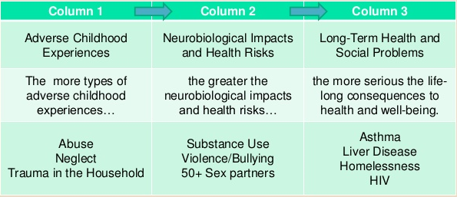
The ACE Comprehensive Chart

Slide 38
ACE Exposure and Education
As early as the 1960’s research established direct connections between childhood disadvantage and diminished educational outcomes.
  Disparities in early-childhood experience produced disparities in cognitive skill – most significant, in literacy- that could be observed on the first day of Kindergarten and well into adulthood.
Among patients with an ACE score of 0, just 3% display learning/behavior problems.
Among patients with a score of ≥ 4, the figure is 51%.*
    *Burke, J., Hellman, J., Scott, B., Weems, C. & Carrion, V. The impact of adverse childhood experiences on an urban pediatric population. Child Abuse & Neglect, 2011:35(6): 408-413

Slide 39
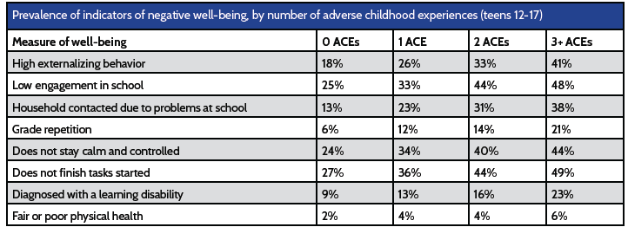
ACE’s & Negative Well-Being

Slide 40
Why Should Schools Be Trauma Informed?
Children are more likely to access mental health services through primary care and schools than through specialty mental health clinics
Over 70% of students who do receive mental health services, receive those services in schools
Children with mental health disorders struggle in school and are less likely to succeed academically
(Costello et. al., 1998; Duchnowski, Kutash & Friedman, 2002; Mental health America of Greater Houston, 2011; SRI International, 2015)

Slide 41
Trauma and our Students
Danger and safety are the core concerns of traumatized children even in mostly safe places like school.
Traumatic events outside school can generate distressing reminders in the hallway, in the classroom or anywhere on school grounds that interfere with a student’s ability to regulate their emotions and to learn.
Protective factors, such as positive relationships with teachers and peers in schools can reduce the adverse impact of trauma
Trauma plays an major role among at risk and special populations: Children in the Child Welfare and Juvenile Justice Systems, Children in Special Education, LGBTQ Children, Children in Areas of Poverty, Gang Violence and Crime, Children with MH Challenges, etc.
Wong, 2013

Slide 42
How Trauma Affects Learning
Traumatic stress from adverse childhood experiences can undermine the ability to form relationships, regulate emotions, and impair cognitive functions.
Hyper arousal, intrusion or constriction may interfere with processing of verbal/nonverbal and written information
Ability to organize material sequentially may be inhibited due to coming from a chaotic environment.
Difficulty with classroom transitions
Problems with solving from a different point of view, inferring ideas, or working in group/exhibiting empathy may result when students do not feel safe expressing a preference.

Slide 43
Common Triggers for Traumatized Children
Unpredictability or sudden change
Transition from one setting/activity to another
Loss of control
Feelings of vulnerability or rejection
Confrontation, authority, or limit setting
Loneliness
Sensory overload (too much stimulation from the environment)

Slide 44

What might you notice about students?
Difficulty with…
Organization
Cause and effect
Taking another’s perspective
Attentiveness
Regulating emotions
Executive functions
Engaging in the curriculum
Transitions
Notes:
Children can exhibit a wide range of reactions to trauma and loss which affect their ability to learn
Example: 4th grader from Kristin’s school
Traumatized childrens’ lives can be disorganized, unpredictable, and unsafe. Whereas children in nurturing environments learn about patterns, rhythms, exploring the world safely, children who’ve experienced complex trauma may have had much less consistent caregiving; much more unpredictable days and disrupted routines; a lack of self-efficacy, or feeling like they have a impact on and relationship with the world.
Poor boundaries, not knowing where I end and you begin, may struggle with empathy or expressing preference.
May seem distracted, lack focus, be hyperaroused or dissociating.
Children learn to regulate emotions through their relationship with their caregiver. When the caregiver is not emotionally regulated, children may not develop this skill. May be impulsive, aggressive, over/under-react.
These are the frontal lobe/pre-frontal cortex functions of the brain—goal setting, anticipating consequences, planning, evaluating. Critical for academics. Traumatized children may have slower frontal lobe development. They may also have an outlook that is bleak, hopeless low self-worth, which impacts ability to plan for the future
“Trying to play chess in a hurricane”. Focusing on school work while dealing with trauma is VERY hard (like concentrating on work when there are problems at home).

Slide 45
What might you notice about students?
Reactivity and impulsivity
Aggression and defiance
Withdrawal/avoidance
Perfectionism
Repetitive thoughts or comments about death or dying
Non-age appropriate behavior
Anxiety/worry about safety of self and others
Poor or changed school performance and attendance
Overly protective of personal space or belongings
Notes:
IMPORTANT: What is adaptive/resilient in one context may be problematic in another. Ex.—a female 9th grader lives with mom and stepdad, who is an alcoholic. Throughout most of her mid-childhood (ages 8-12) experienced regular domestic violence. When stepdad was drunk, he would become violent toward mom. Student would step in, tried to stop stepdad and protect mom, called police. Student exhibits explosive temper, and will not back down from teachers (especially male) when confronted.
Not every kid reacts to trauma in the same way.
Grief/loss and mental illness share similar symptoms, and may also benefit from similar school interventions and classroom accommodations
Internalizing—stop having emotions because they weren’t responded to anyway
Externalizing—have really big emotions that escalate easily and can’t be controlled
We learn emotional regulation from our caregiver
Anger, fear, anxiety are ALL appropriate reactions to trauma
Weave resilience through this entire section—reemphasize that many of these are appropriate reactions to a very stressful situation. Maybe relate to an experience of how a well-adjusted adult would not be expected to be happy or calm if they were in the midst of grieving the loss of a loved one or just lost their job.

Slide 46
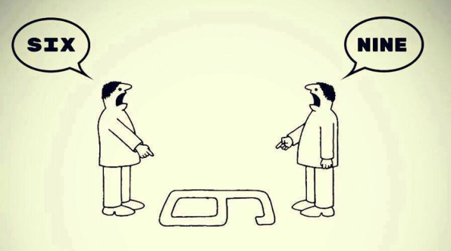
Using a “Trauma Lens”
A shift in perspective…
“What is wrong with this student?” “What has this student been through?”

Slide 47
Schools Can Support Traumatized Students
Build relationships with struggling students
Create a safe and predictable environment with clear, consistent rules
Provide opportunities for students to meaningfully participate in class with some control & responsibility
Embed mental health into the curriculum
Check assumptions, observe, and question
Be a model for appropriate behavior and relational skills
Work with students to create a self-care plan to address triggers

Slide 48
How to Respond
When a Student Is Triggered…
Breathe! Be calm and you will help the student be calm.
Do not use this as a time to try to change behavior or demand respect.
Call for help, or ask another person to call.
Notice your tone of voice and personal space.
Remember that the student is probably not engaged in the pre-frontal cortex right now!

Slide 49
Remember….
Trauma generated behaviors are complex but can be understood and addressed by educators
A positive teacher student relationship may take an investment of more time with a traumatized child
Student-teacher trust must be established before the process of teaching and learning can truly begin
Working with trauma-exposed children can evoke distress in providers that makes it more difficult for them to teach and manage the classroom
Wong, 2013

Slide 50

School-Based Mental Health Interventions
Individual counseling services
Safety/crisis planning
Behavior plans
Therapeutic & skill-building groups
Youth development activities
Case/Care management
Notes:
It’s important that your staff know what is available to your school, and what is happening in theSchool-Based Health Center, therapist’s office, counselor’s office, etc. You demystify the services, so teachers are more comfortable referring students, and are maybe more receptive to the idea of confidentiality.
Individual counseling: Identify root issue, build self-regulation skills, provide safe and confidential space for student
Safety/Crisis Planning: Identify triggers and ways to avoid or manage, identify safe/supportive people to call when in crisis
FBPs: More for SPED/IEPs, but gets very specific in identifying challenging behaviors, antecedents, and interventions.
Groups: builds developmental tasks, helps students realize they are not alone, share coping strategies
Youth Development: provide opportunity for positive youth development involvement, build skills, experience leadership, teach others about health issues
Case Mgmt: Working with families, linking services among several providers, provide “tangible” support, link to academic and academic improvement

Slide 51
Examples of Services and Programs
Psychological First Aid: Listen Protect Connect
Support to Students Exposed to Trauma (SSET)
PBIS
Restorative Practices
Range of Activities – Student Interest Groups
Community Internships
Crisis Intervention
Mental Health Services
Threat and Risk Assessment teams
  Intimidation and Bullying
  Stalking
  Relationship violence
  Weapons possession
  Suicidal behavior
  Physical Assault
  Wong, 2013
Notes:
MARLEEN these items are drawn from your article so I imagine you’ll be able to extemporize here.

Slide 52
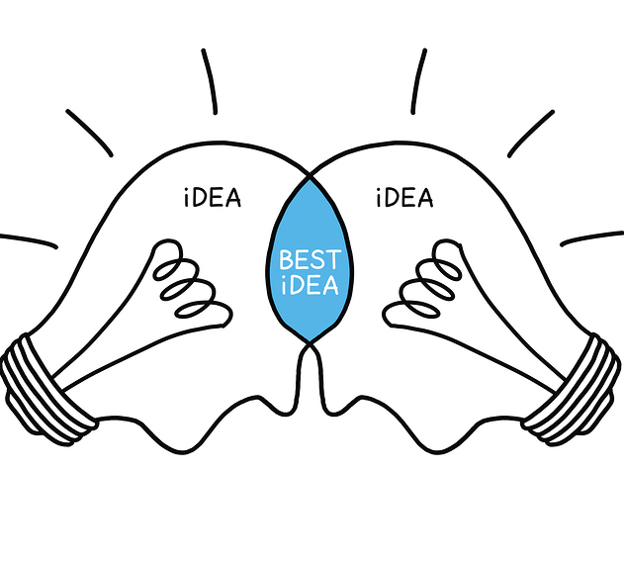
Trauma-Informed Schools Require Broad Partnerships
A partnered approach engages all stakeholders
Implement components in a manner that fits within each schools’ unique organizational structure and culture
Wong, 2013
Notes:
Emphais on a parntered approach that engages everyone on campus. This is a way to produce a truly trauma informed environment From our perspective it’s not about implementing a one size fits all approach but creating a culture shift within the school community and broader local community. And also bringing partners together to deevelop approach that will work within each schools unique environment In doin
From our perspective it’s not about implementing a one size fits all approach but creating a culture shift within the school community and broader local community.

Slide 53
How Can School Staff Help?
Entire Classroom
Establish classroom agreements for behavior
Provide routines and consistency
Provide explicit preparation for changes and transitions
Create time in schedule fo community building, circles, mindfulness
Give opportunities for expression
Teach about the power of mindsets
Individual & Groups of Students
Build 1:1 relationships with struggling students
3:1 ratio of positive to negative
Allow students to step outside of the classroom or put their head down
Use restorative practices language
Seat students near the front or near you
Mind-Brain body breaks

Slide 54

Mind-Brain-Body Breaks
Deep breathing
Progressive relaxation
Stretching or Movement
Imagery
Mindfulness
Quiet Ball
One-minute Dance Party
Gonoodle.com
www.brainbreaks.blogspot.com
http://www.coloradoedinitiative.org/resources/teacher-toolbox-activity-breaks/
Notes:
When I’m presenting to a high school audience, this might be new information, but I suspect that an elementary or middle school audience is well-versed in providing breaks for students during the day. This is just a few resources if teachers are looking for new, fun ways to introduce brain breaks into their curriculum, or strategies to teach individual students to self-soothe.
Inhale deeply through nose, hold for 2 counts, exhale through nose, hold for 2 counts. Do 10-15 rounds
Tense every muscle, including shoulders, fists, toes etc. Progressively release from toes up to head.
Any type of physical activity or stretching, possibly led by students!
For 2 minutes, toss a beach ball around the room, trying to keep it from touching the ground. Students are “out” if they drop the ball, throw it hard at anyone, talk etc—you make the rules!
Play a popular song and have one student lead the others in simple, replicable dance moves
Students start by playing “rock, paper, scissors” in pairs. After winner is decided, pair becomes a team and challenges another pair. Then pair becomes a four-some, and challenges another four-some, until 2 groups are competing. For “People Tigers Traps” you create your own movements that correspond with each.

Slide 55
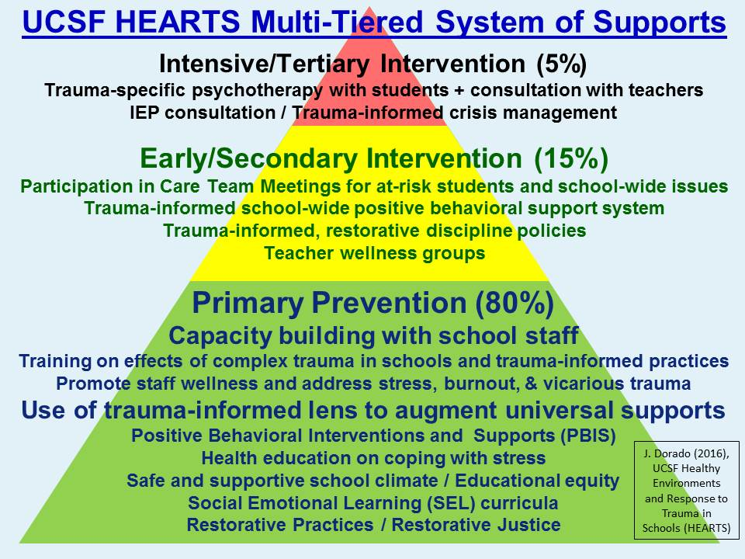

Slide 56
Tips for School Staff
Coordinate efforts with others and make referrals
Let students know you care by listening, empathizing, and providing structure
Support and encourage participation in programs at your school that build relationships and student assets
Offer ways for families to connect to your school
Don’t make promises you can’t keep
When you become aware of a student who has experienced trauma, ask for help

Slide 57
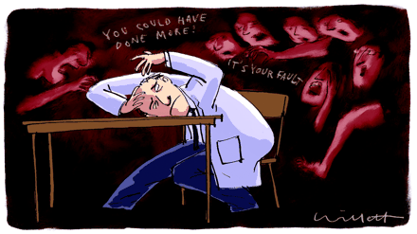
Secondary Traumatic Stress (STS)
“It is not uncommon for school professionals who have a classroom with one or more students struggling from the effects of trauma to experience symptoms very much like those their students are exhibiting.”
The Heart of Learning and Teaching: Compassion, Resilience, and Academic Success

Slide 58

Early recognition is important!
Compassion Fatigue/Secondary Traumatic Stress
Any educator who works directly with traumatized children and adolescents is vulnerable to the effects of trauma
You may be even more susceptible to STS if you have:
  Personal exposure to a traumatic event or to individuals who are coping with one
  Direct contact with children's’ traumatic stories
  Are helping others and neglecting yourself

Slide 59
Know the Signs of STS
Emotional — feeling numb or detached; feeling overwhelmed or maybe even hopeless.
Physical — having low energy or feeling fatigued.
Behavioral — changing your routine or engaging in self-destructive coping mechanisms.
Professional — experiencing low performance of job tasks and responsibilities; feeling low job morale.
Cognitive — experiencing confusion, diminished concentration, and difficulty with decision making; experiencing trauma imagery, which is seeing events over and over again.
Spiritual — questioning the meaning of life or lacking self-satisfaction.
Interpersonal — physically withdrawing or becoming emotionally unavailable to your co-workers or your family.

Slide 60
Managing STS
Don’t go it alone
  Guard against isolation, work in teams, talk with others
Address your own traumas
Seek professional help if symptoms last longer than 2-3 weeks
STS Happens!
        It’s an occupational hazard, and not a failing on your part

Slide 61
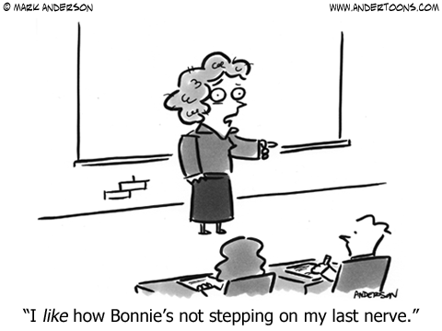
Practice Self Care
Your work is not the only activity that defines you!
  Spend time with those who are not experiencing trauma, both adults and youth
  Eat well
  Exercise (yoga & meditation are useful)
  Do what makes you happy
  Take a break during the workday, even if it’s only a 5 minute walk (deep breathing is a great break!)
  Crying is ok….
    But find things to laugh about too

Slide 62
Resources
Transforming Trauma-Schools with Informed Care
  https://www.schoolcounselor.org/asca/media/asca/ASCAU/Trauma-Crisis-Management-Specialist/TransformingSchools.pdf
Helping Traumatized Children Learn
  https://traumasensitiveschools.org/trauma-and-learning/#principal
Treatment and Services Adaption Center
  https://traumaawareschools.org/secondaryStress
National Child Traumatic Stress Network
  http://www.nctsn.org/products/self-care-educators-dealing-secondary-traumatic-stress

Slide 63
And More….
Adolescent Health Working Group
  www.ahwg.net
Harvard Center on the Developing Brain
  http://developingchild.harvard.edu/
Reaching Students with Emotional Disturbances
  https://www.edutopia.org/article/reaching-students-emotional-disturbances-lori-desautels
OCDE Student Mental Health Resources
  www.ocde.us/HealthyMinds/Pages/Resources.aspx

Slide 64
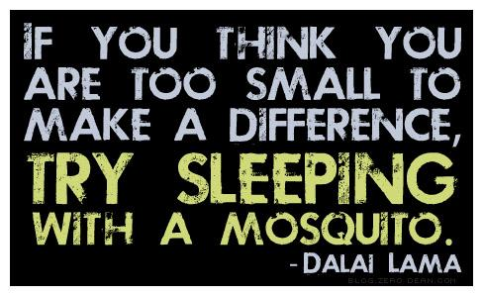

Slide 65
Session Survey - Thank you for attending.
Please provide feedback for this session by pressing Feedback Survey under the session title you are attending within SCHED.
You can access the link through the SCHED app or by
going to https://2018mtsspli.sched.com/.
Thank you.

